Slide 1

Evaluation of Different Models Based on Sentiment Analysis
Ahsanullah University of Science and Technology
Computer Science and Engineering Department
Presented By-
Amin Ahmed Toshib - 170104061
Shifat Islam - 170104100
Nazmus Sakib - 170104104
Submitted To-
Md. Tanvir Rouf Shawon
Farzad Ahmed

Slide 2
Motivation
With public sentiment, nothing can fail. Without it, nothing can succeed.-Abraham Lincoln
Human emotional condition analysis
Prediction of appropriate emotion
Customers feedback analysis
Predicting box-office revenues from movie reviews
Why?

Slide 3
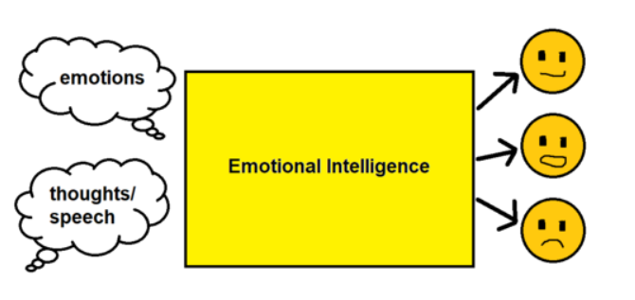
Objectives
Evolution of different models
Classification metrics measurement
Using machine learning and deep learning techniques
6 basic emotions -
1. Happiness 2. Sadness
3. Neutral 4. Anger
5. Surprise 6. Worry

Slide 4
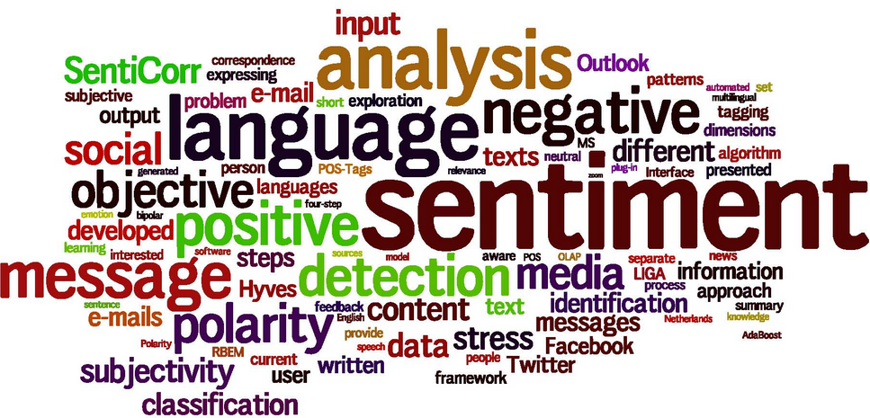
Introduction
Understanding emotions expressed in language can be used in many applications.
Analysis of sentiments on social networks such as Twitter and Facebook.

Slide 5
Background Study
Text preprocessing libraries
Word embedding techniques
Machine learning algorithms
Classification metrics
Confusion matrix

Slide 6
Data Acquisition
There are two different dataset where we experiment our model for comparison:
Tweet-Emotion
Go-Emotion

Slide 7
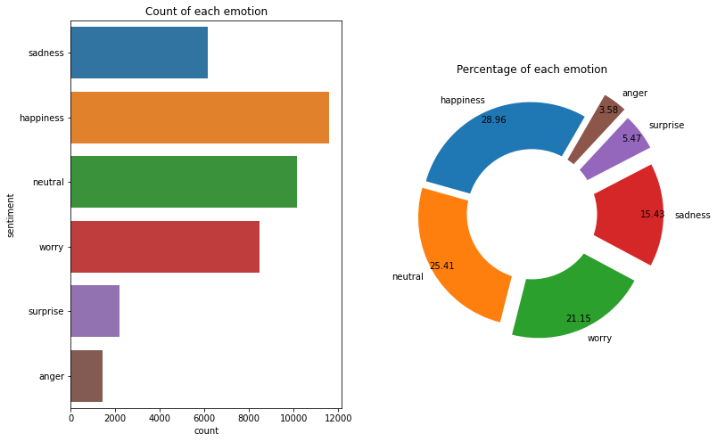
Data Statistics

Slide 8
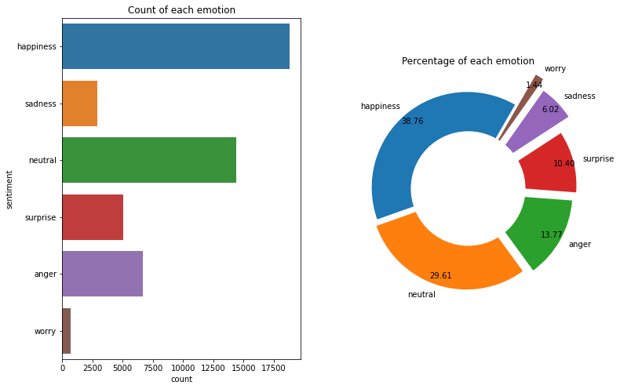
Data Statistics (continued)

Slide 9
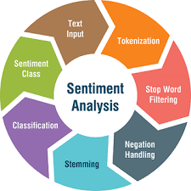
Methodologies
Dataset Preprocessing
Text Preprocessing
Text Classification
Sampling Data
Model Evaluation

Slide 10

Dataset Preprocessing
Drop unnecessary emotions
Add characters and tokens length columns

Slide 11
Text Preprocessing
Html parser
Remove punctuation
Remove non-ascii characters
Remove stopwords
Stemmatization
Lammetization
Tokenization

Slide 12
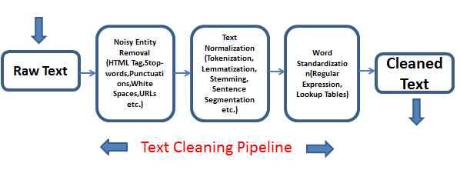
Text Preprocessing Workflow

Slide 13
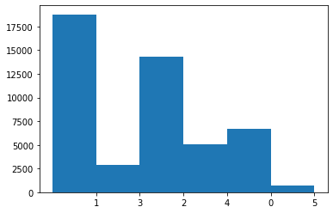
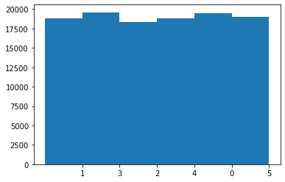
Data Sampling
Oversampling technique Adasynn(adaptive synthesis)
Actual dataset
Feature Scaling

Slide 14
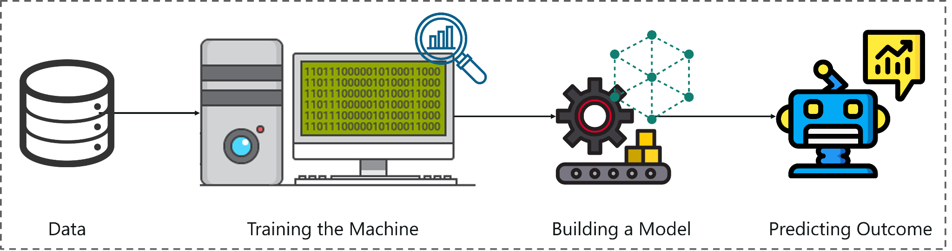
Text Classification Models
Random Forest Classifier
Extreme Gradient Boosting(XGB)
Support Vector Machine(SVM)
Naive Bayes Classifier
Logistic Regression
SGD Classifier

Slide 15
Result Analysis (Dataset 1)
Model | Accuracy(%) | Precision(%) | Recall(%) | F1-score(%)
Random Forest | 55.87 | 47 | 45 | 44
SVM | 57 | 49 | 46 | 45
XGB Classifier | 54.47 | 45 | 44 | 44
Logistic Regression | 55.01 | 49 | 44 | 42
SGD Classifier | 51.85 | 42 | 41 | 38
Naive Bayes | 51.22 | 40 | 39 | 35

Slide 16
Result Analysis (Dataset 2)
Model | Accuracy(%) | Precision(%) | Recall(%) | F1-score(%)
Random Forest | 86.49 | 87 | 86 | 86
SVM | 90.06 | 90 | 90 | 90
XGB Classifier | 83.72 | 84 | 84 | 84
Logistic Regression | 75.69 | 76 | 76 | 76
SGD Classifier | 72.5 | 72 | 72 | 71
Naive Bayes | 73.25 | 73 | 73 | 73

Slide 17
Research Gap & Challenges
Inadequacy of sentiment datasets
Imbalance datasets
Emoji problem in datasets
Polarity problem
Wrong prediction from manually annotated data

Slide 18
Conclusion
In dataset 1, imbalancing problem affect the model and lowers the accuracy which is 57% in SVM model.
With balanced dataset 2, the same SVM model performed really well giving an accuracy a little over 90%.
Difference in accuracy because of a dataset is in balanced and imbalanced. In near future, we hope to research more on this topic.

Slide 19
Thank You...
Any Questions?

